Slide 1
Warfarin Adjustment and Review by Pharmacists in an Inpatient Setting (WARPh)

Slide 2
Disclosure
The authors of this presentation have nothing to disclose concerning possible financial or personal relationships with commercial entities that may have a direct or indirect interest in the subject matter of this presentation.

Slide 3
Background
  Vitamin K antagonists have been a mainstay of oral anticoagulant therapy with warfarin being the most common one in clinical use today²
  Warfarin is a high-risk medication with a narrow therapeutic index¹
  Interindividual differences in drug metabolism, comorbidities, lifestyle, and use of interacting medications can significantly influence anticoagulant effect as well as bleed risk¹
  Traditionally, anticoagulation management has been a physician responsibility²
  However, pharmacists have become more involved in its management and recent studies have demonstrated improvements in patient care when a pharmacist manages warfarin compared to traditional management^{2,4}

Slide 4
Study Objectives
  Primary Objective:
  Evaluate the effectiveness of a pharmacist managed warfarin service compared to traditional physician warfarin management in an inpatient setting at Peconic Bay Medical Center
  Secondary Objectives:
  Increase time in therapeutic range (TTR)
  Decrease time to goal INR, frequency of supratherapeutic INRs
  Transition towards the creation of a Pharmacy Managed Warfarin Consult service

Slide 5
Study Design and Methodology
  IRB exempt quality improvement study
  A pharmacy-based warfarin protocol was reviewed and approved to run from January 4th, 2021 to March 26th, 2021
    Enrolled all warfarin patients managed by general medicine teams
  Compared warfarin patients managed by pharmacy during the study period to data gathered from traditionally monitored patients
  For the control arm, warfarin patients from 2020 utilization data were randomly selected through a random date generator

Slide 6
Study Design and Methodology
  Inclusion Criteria:
    Patients must have received at least 3 doses of warfarin inpatient and at least 3 INR readings during their stay
  Exclusion Criteria:
    Patients were excluded if they had received less than 3 doses of warfarin inpatient or less than 3 INR readings during their stay, or were admitted to the following services: intensive care unit (ICU), cardiovascular surgery, pediatrics, or orthopedic surgery

Slide 7
Study Design and Methodology
  An INR range of 2.0-3.0 was targeted as therapeutic
    Any INR above 3.5 was considered supratherapeutic
  Daily warfarin reports were generated twice daily, in the morning and the afternoon
  Hospitalists continued to order 1st dose of warfarin
    Pharmacists contacted physicians to enroll patients and managed dosing afterwards
  Pharmacists were responsible for ordering daily doses, pertinent labs, reviewing INRs and drug interactions, and documenting in the electronic medical record
  Time in goal INR was assessed as the percentage of time each patient stayed in goal range during hospital stay

Slide 8
Study Design and Methodology
  A fisher’s exact test was used for the primary endpoint of showing a predetermined difference greater than 20% in the number of days a patient’s INR remained in goal range during stay and the secondary endpoint of number of patients with supratherapeutic INRs during their stay
  A t-test was performed for the following secondary endpoints:
    Average number of days patients bridged
    Average time to goal INR (days)
      New starts
      Patients continuing warfarin therapy
  Descriptive statistics were utilized for secondary endpoints that did not require a t-test and for all demographics

Slide 9
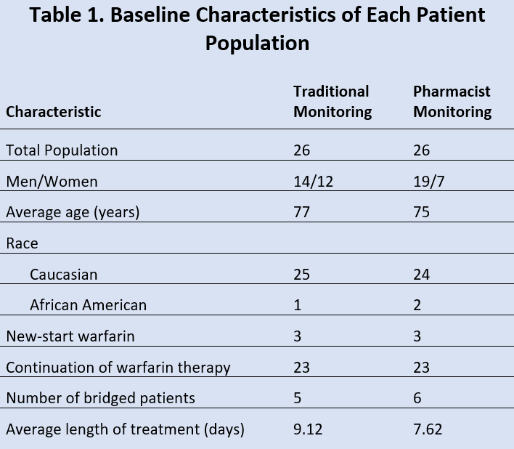
Results

Slide 10
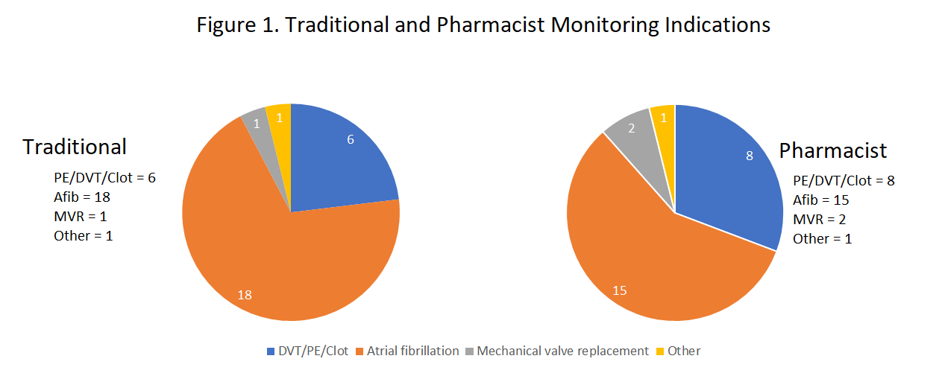
Results

Slide 11
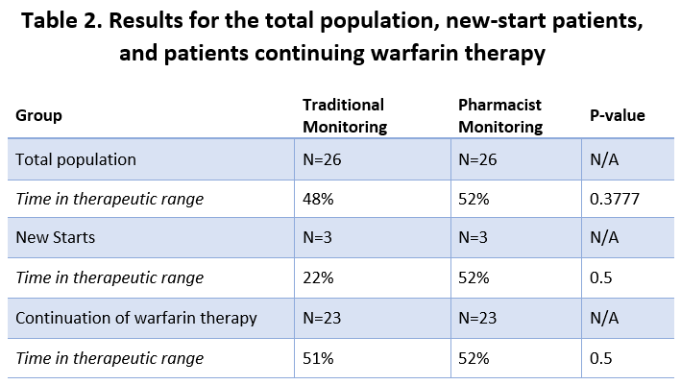
Results

Slide 12
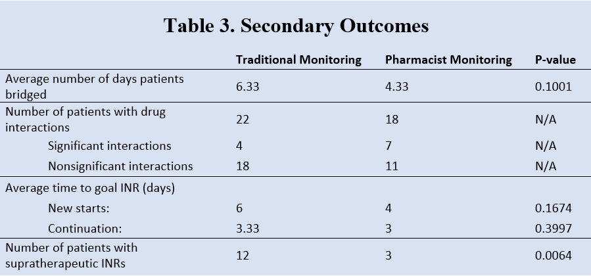
Results

Slide 13
Discussion
  The results of this study demonstrated a similar amount of time in therapeutic range between the traditional monitoring group and the pharmacist monitoring group
  The primary endpoint did not demonstrate statistical significance to show that pharmacist monitoring was superior to traditional monitoring (48% vs 52%, p = 0.3777)
    This finding was true when patients were analyzed for new starts as well as patients continuing their warfarin therapy (new starts: 22% vs 52%, p=0.50; continuing: 51% vs 52%, p = 0.50)

Slide 14
Discussion
  However, the pharmacist monitoring group overall did show a trend with results that were superior to traditional monitoring
    Average number of days bridged (6.33 vs 4.33)
    Average time to goal INR (6 vs 4)
  The secondary endpoint for number of patients with supratherapeutic INRs during their stay showed statistical significance
    More patients had supratherapeutic INR in the traditional monitoring group when compared to the pharmacist group (12 vs 3 [46% vs 12%], p = 0.0064)

Slide 15
Discussion
  There were several limitations to this study
  This was a single-center study with a small patient population (n = 52)
    Although not statistically significant, all the endpoints did demonstrate better outcomes in the pharmacist monitoring group
    It is possible that if the study had a longer study period and a larger sample size, that we would see a statistically significant benefit in pharmacy management of warfarin
  Prior to the study, pharmacists still monitored and reached out to physicians about dose changes
    May have blunted the actual impact of pharmacy managing warfarin dosing

Slide 16
Discussion
  In our current protocol, hospitalists continued to order the 1st dose of warfarin and pharmacy adjusts afterwards
    This is another potential limitation since the 1st dose of warfarin patients receive can affect their INR values in subsequent days and would have a large impact especially if these patients have a short stay

Slide 17
Future Directions
  Initiate a Pharmacy Managed Warfarin Consult Service
    Physicians to put in an order that indicates “Warfarin: Pharmacy to Manage”
  Expand pharmacist warfarin service to all services beyond general medicine
  Expansion of protocol to allow for automatic discontinuation of full dose Lovenox once patient is therapeutic

Slide 18
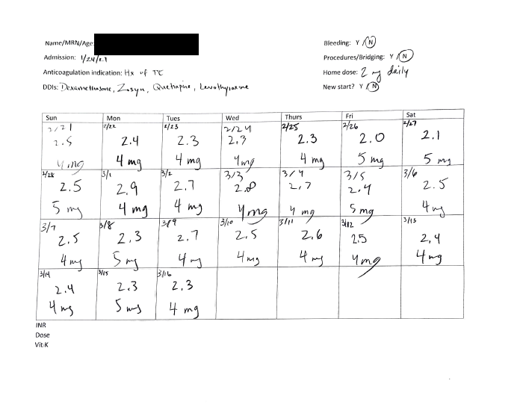
Future Directions
  Create a process to provide patients with their inpatient warfarin monitoring sheets prior to discharge to improve transitions of care

Slide 19
Conclusion
  The pharmacist monitoring group demonstrated similar time in therapeutic range as the traditional monitoring group and showed lower incidences of supratherapeutic INRs
  This study supports the creation of a Pharmacy Managed Warfarin Consult service
    May decrease supratherapeutic INRs and bleed risk, while maintaining and perhaps even increase TTR
  The addition of pharmacist monitoring for hospitalized patients on warfarin may also be cost-effective⁴
    Decreasing length of stay

Slide 20
References
  Biscup-Horn, P. J., Streiff, M. B., Ulbrich, T. R., Nesbit, T. W., & Shermock, K. M. (2008). Impact of an inpatient anticoagulation management service on clinical outcomes. Annals of Pharmacotherapy, 42(6), 777-782.
  Hannan, C., & Holden, L. (2012). Impact of an Inpatient Anticoagulation Monitoring Program. US Pharm, 2, 17.
  Kuruvilla M, Gurk-Turner C. A review of warfarin dosing and monitoring. Proc (Bayl Univ Med Cent). 2001;14(3):305-306. doi:10.1080/08998280.2001.11927781
  Mamdani MM, Racine E, McCreadie S, Zimmerman C, O'Sullivan TL, Jensen G, Ragatzki P, Stevenson JG. Clinical and economic effectiveness of an inpatient anticoagulation service. Pharmacotherapy. 1999 Sep;19(9):1064-74. doi: 10.1592/phco.19.13.1064.31591. PMID: 10610013.

Slide 21
Questions?
yjing@northwell.edu
Yaxun Jing
PGY-1 Pharmacy Resident
Peconic Bay Medical Center – Northwell Health

